Slide 1


The main scientific publications
Единая государственная сеть вычислительных центров
The Unified State Network of Computing Centers
Anatoly Ivanovich Kitov
Head of the department of computer technology and programming of Russian Plekhanov University of Economics, Honored Worker of Science and Technology of the USSR, academician of the Russian Academy of Natural Sciences, doctor of Technical Sciences, professor

Slide 2
Anatoly Kitov (1920-2005) - an outstanding Soviet and Russian scientist, the founder of a number of scientific directions in the USSR. He wrote first soviet leading monographs and textbooks on computers, programming, algorithmic languages, automated management systems, information systems for defense, economics and medicine. He carried out a large practical work on the computerization of these directions. In the USSR, A.I. Kitov was one of the main fighters for the rehabilitation of the cybernetics, referred as "bourgeois pseudoscience“ in the USSR, being the author of the first positive publication about it. He was a convinced propagandist of cybernetic's ideas.
Scientific works and articles written by him independently and jointly with A.I. Berg, A.A. Lyapunov and S.L. Sobolev, dating back to the period 1952-1961, played a huge role in the recognition of cybernetics as science and the development of computer science in the Soviet Union and in other countries.
A.I. Kitov is known as the first who raised the question of the need to create a Joint computer network for the management of the national economy of the USSR on the basis of the common network use of the all computers and economic-mathematical methods.
Technically this global computer system, according to his proposal, should be as a global computer network covering the entire territory of the USSR and consisting of thousands of computer centers. In 1958, A.Kitov published these ideas of the creation of the Joint State Network of Computing Centers (EGSVC in Russian) in the brochure "Electronic computers", published in mass circulation by the All-Union Society “Znanie". In January 1959, A.I. Kitov sent the letter to the First secretary of the Communist Party and the Chairman of the Council of Ministers of the USSR N.S. Khrushchev. In this letter he proposed to radically change the methods and means of managing the economy of the Soviet Union by "moving from manual and personal forms of management to automated systems based on the wide use of computers".
This letter served as a serious catalyst for the development of computer production in the USSR. But the main idea of A. Kitov about the restructuring of the management of the national economy on the basis of the EGSVC was ignored by the Soviet leadership. Then in autumn 1959, A.Kitov sent his second letter to N.S. Khrushchev. The first part of this letter contained sharp criticism of a number of leaders and, in the first place, the leadership of the Soviet Ministry of Defense for the slowness of implementation of the usage of computers.

Slide 3
The main part of the letter was Kitov's project "On measures to overcome the backlog in the creation, production and introduction of computers into the Armed Forces and the national economy of the country". It was the first project in the world to create a national global computer network (the prototype of a modern Internet network). The project proposed to unite all computers available in the country into the Unified State Network of Computing Centers (in Russian EGSVC) of dual purpose for solving both national economic (in peacetime) and defense tasks (in wartime). In case of war emergency, the computers of this network had to switch to solving military problems.
As Anatoly Kitov noted in one of his interview: "The report I made before the commission, headed by Marshal K.K. Rokossovsky, contained a serious criticism of the state of affairs with the usage of computers in the country. This caused a negative reaction among two dozen listeners, mostly generals. As a result, the commission rejected my project, calling it irrational, because, in their opinion, it was not permissible to mix military and civil tasks. In fact, it seems to me, that people from the high communist structures were not satisfied with the fact that as a result of the widespread introduction of computer technology, many of them might lose their jobs. I was expelled from the Communist party and removed from position of scientific deputy chief of the computer center #1 of the Ministry of Defense, which I have occupied since 1954".
Despite the rejection of the Kitov's large-scale project, the proposals contained in it formed the basis for subsequent proposals for the EGSVC (1964) and the National Automated System (OGAS, 1980).
In 1958 under the leadership of Anatoly Kitov the world's fastest lamp computer “M-100” was created, which performed one hundred thousand operations per second. A.Kitov is the creator of the theory of associative programming and two algorithmic languages: ALGEM for programming economic and mathematical problems and NORMIN for computer processing of texts in a natural normalized language (in the USSR this algorithmic language widely was used to solve public health and medical problems).
After the dismissal from the Armed Forces A.Kitov was the Chief Designer in the creation of an industrial automated management system for the Ministry of Radioindustry (in Russian OASU MRP), recognized as a standard computer management system for the nine soviet ministries of defense industry and later worked as the Chief Designer of the Automated management System "Healthcare". He is the founder of the Soviet military and medical cybernetics.
During twelve years A.I. Kitov officially represented the USSR in prestigious organizations in the field of medical informatics IFIP and MedINFO. Since 1980, A.I. Kitov headed the Department of computer technology and programming in the Russian Plekhanov university of Economics, where he worked for 17 years.
A.I. Kitov is the author of numerous articles, twelve monographs and textbooks translated into nine foreign languages.

Slide 4
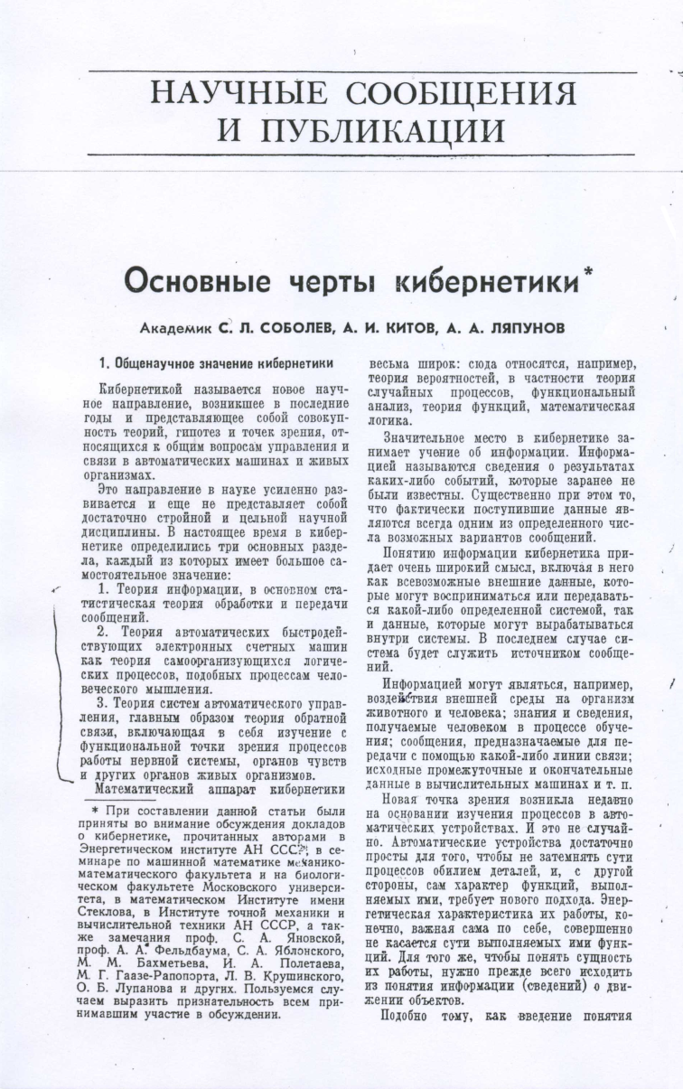
Article "The main features of cybernetics". Journal "Questions of Philosophy", No. 4, 1955.
Until 1955, cybernetics in the USSR was banned and was referred to only as a “bourgeois pseudoscience”.
In 1951-52 years, A.Kitov, having got acquainted in the library of the secret design bureau for the design of computers SKB-245 with the book "Cybernetics" by N. Wiener (USA), immediately appreciated the great benefit for the Society that this new science could bring. Not only appreciated, but also wrote an unfolded positive article "The main features of cybernetics," which required true civil courage at Stalin's time and early post-Stalin's time.
Then, it took about one and a half years of public speeches about cybernetics of A.Kitov and a small group of his associates before the Ideological Department of the Central Committee of the CPSU authorized the publication of this article.
In the middle of 1955 this article with author's signatures of S.L. Sobolev, A.I. Kitov and A.A. Lyapunov was published in the main ideological communist journal “Questions of Philosophy”. This article entered the history of Russian science as a victorious point in the struggle for cybernetics in the USSR, where the most active role was played by Anatoly Kitov.

Slide 5

Publication in Japan of the article "The main features of cybernetics“. Tokyo, SYUNDSU-Sy", 1956.
In June 20, 1956 the article "The main features of cybernetics" by S.L. Sobolev, A.I. Kitov and A.A. Lyapunov was published in Japan. This was the first positive article in the USSR and the countries of the socialist camp which rehabilitated cybernetics, which was always referred to as "bourgeois pseudoscience“ before. President of the Soviet Academy of Sciences (in 1986-1991) G.I. Marchuk appreciated the significance of this article this way: "In 1955, in the fourth issue of the journal “Questions of Philosophy”, the first positive article on the cybernetics of S.L. Sobolev, A.I. Kitov and AA Lyapunov, in which the authors deeply and substantively formulated the significance of cybernetics, which in those days was subjected to staggering attacks by the scientific community. In the article the authors considered the general scientific significance of cybernetics as the emerging theory of computer science, the theory of electronic computers and the theory of automatic management systems. This article was of great importance for understanding the new field of knowledge and implemented a turning point in the minds of people who received the firm foundation of the new emerging science. The importance of this article for science can not be overestimated".

Slide 6
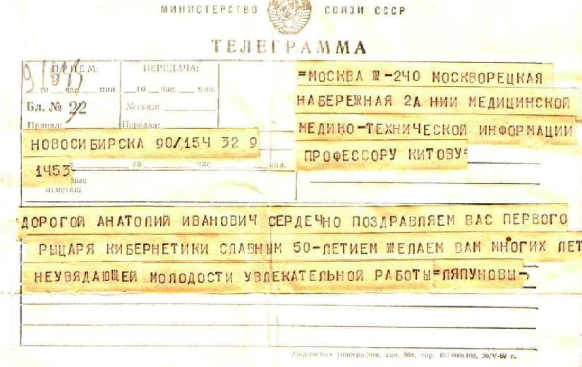
Congratulatory telegram from professor A.A. Lyapunov to A.I. Kitov (August 9, 1970, Novosibirsk Akademgorodok), in which he named A. Kitov as the first knight of cybernetics.

Slide 7

A.I. Kitov "Electronic digital computers“.
Moscow. Publishing house "Soviet radio", 1956, 276 p.
The first soviet book on programming, computers and their various applications. The final third part of this book is devoted to "Non-arithmetic use of computers" - the use of computers for managing production processes, solving different problems of the economy, artificial intelligence, computer translation from one language to another etc.
This book was translated into several foreign languages ​​and published in USA, China, Poland, Czechoslovakia and other countries. About this book the President of the Academy of Sciences of the USSR G.I.Marchuk wrote "The book "Electronic digital computers" published in 1956 by A.I.Kitov actually made a revolution in the minds of many researchers ... A.I.Kitov's books, written at the beginning of the era of computers in our country, should not be forgotten."
An outstanding scientist V.Glushkov noted: "A.I.Kitov is a recognized pioneer of cybernetics, who laid the foundations of the national school of programming and computer application for solving military and economic problems. I myself, like tens of thousands of other specialists, received my initial computer knowledge from his book "Electronic digital computers" - the first book in the country on computers and programming".
University of Michigan’s professor John Carr (John Carr, USA) wrote in his monograph "Lectures on programming" (1958, USA) on the basis of an analysis of 150 books about computers released in the world at that time: "The questions of both manual and automatic programming are best covered in Anatoly Kitov's book "Electronic digital computers".

Slide 8

A.I. Kitov, N.A. Krinitsky, P.N. Komolov "Elements of programming" (for electronic computers). Edited by A.I. Kitov.
Publishing house of the Artillery Engineering Academy, Moscow:, 1956, 286 p.
Published in 1956, almost six months after A.Kitov’s monograph "Electronic digital computers", this three-hundred-page book became the second widely available computer monograph in the USSR.
This book by A. Kitov and his previous pioneer book "Electronic digital computers" covered a huge shortage of literature on computer technology, which existed at that time in the Soviet Union.
The conclusion of this book is extremely clearly stated: "The widespread use of these machines (computers) will raise all new types of production in our country to a new all-time high level, will improve the material well-being of our people and significantly strengthen the defense capability of our Motherland".

Slide 9
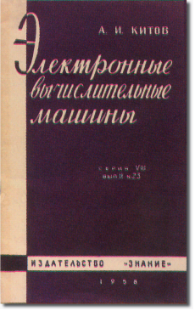
A.I.Kitov "Electronic computers"
Moscow, Publishing house "Znanie", 1958
At 1958 in the publishing house “Znanie" was published the brochure of A.I. Kitov "Electronic computers", which describes the possible applications of computers for mathematical calculations, automation of production management and the solution of economic problems.
For the first time on the basis of the Unified State Network of Computing Centers (EGSVC network), the perspective of a comprehensive automation of information processing and administrative management processes across the country was outlined.
A.I. Kitov appended this brochure to his first letter to the head of the USSR N.S. Khrushchev on January 7, 1959.

Slide 10

A.Kitov and N.Krinitsky "Electronic computers"
Moscow, Publishing house “Nauka” of the USSR Academy of Sciences, 1958,
(second edition 1965), 132 p.
This book was translated into English by the international publishing house "Pergamon Press" and published in the USA, Great Britain, Czechoslovakia, France and other countries.
This book was published under the editorship and with a foreword by academician A.Dorodnicyn.
In 1965, the publishing house of the Academy of Sciences of the USSR issued the second, substantially revised and enlarged edition of this book.
The total circulation of the two editions of this book was 61,000 copies.

Slide 11

A.Kitov, N.Krinitsky "Electronic digital machines and programming“. Moscow, Publishing house "Nauka" (FIZMATGIZ), 1959, 572 p.
This book is the first in the USSR official textbook on computers and programming, officially approved by the Ministry of Education of the USSR for study in universities.
About this book the President of the Academy of Sciences of the USSR G.Marchuk wrote: "In 1959 another Kitov's fundamental work appeared, written together with N. Krynitsky - "Electronic digital machines and programming". It was actually an encyclopedia of computer science. Many generations of students of universities of the country with the help of this remarkable book received fundamental education and have become first-class scientists in many fields of knowledge".
This textbook-encyclopedia was published in Romania, Hungary, the German Democratic Republic and a number of other countries.

Slide 12

A.Kitov, N.Krinitsky "Electronic digital machines and programming. Moscow, Publishing house "Nauka" (FIZMATGIZ). Second edition. 1961, 572 p.
The second stereotypical edition of the textbook-encyclopedia of A.Kitov and N.Krinitckiy "Electronic digital machines and programming".
About this book in his memoirs veteran of the chair of computer technology MEI university (the first chair of computers science in the USSR), doctor of Technical Sciences, Professor A.K. Polyakov wrote as follows: "In my opinion, the textbook of A.Kitov and N.Krynitsky "Electronic digital machines and programming" at that time was the best in the world“.
The total circulation of foreign and two Soviet editions amounted to over 130 000 copies.

Slide 13
A book-collection of scientific articles edited by A.I. Kitov "Digital computers and programming" (Issue No. 1).
Moscow. Publishing House "Sovetskoye Radio", 1966, 182 p.
From 1966 to 1974 A.I. Kitov was the editor-in-chief of the All-Union collection of scientific articles "Digital computers and programming", which he founded.
This collection of scientific articles was devoted to theoretical and practical issues of computer development, information technologies, applications and programming problems.
The editorial board of the collection of scientific articles was made up of famous Russian scientists in the field of computers and programming N.A. Krinitsky, G.A. Mironov, G.D. Frolov, A.G. Shigin, Z.Z. Lyubimsky, A.N. Nechaev and others.
In total, from 1966 to 1974, eight volumes of this scholarly collection were published.

Slide 14

A.I. Kitov The monograph "Programming of Information-Logical Problems“.
Moscow. Publishing House "Sovetskoye Radio", 1967, 328 p.
The main part of this monograph presents developed by A.Kitov new information technology "Associative programming". It was a new method of computer processing of data stored in large information arrays. This method was an effective way of solving information-logical problems, especially economic ones.
The book also describes created by A.Kitov new algorithmic programming language for economic and mathematical problems ALGEM (Economic and Mathematical Algorithms), which was implemented industrially in hundreds of enterprises of the USSR and countries of Eastern Europe.
The monograph contains a number of non-secret scientific results obtained during the work of A.Kitov on a doctoral thesis on the theme: "The computer solution of the air defense problems of the country", which he defended in 1963 in the Institute of management problems of the Russian Academy of Sciences.

Slide 15

A.I. Kitov "Programming of economic and management problems“.
Moscow. Publishing House "Sovetskoye Radio", 1971. 371 p.
In the book "Programming of economic and management problems", A.I. Kitov summarized his experience as the Chief Designer of the Industry Automated Management System of the Ministry of Radio Industry (in Russian OASU MRP).
This OASU MRP was recognized by the Government of the USSR as a standard model industry automated management system for all nine defense-industry ministries of the Soviet Union.
In this book, A.I. Kitov formulated the basic principles for creation of industrial and enterprise automated management systems (in Russian OASU and ASUP).

Slide 16
"Automation system for programming ALGEM"
Edited by professor A.I.Kitov.
Moscow. Publishing House "Statistics", 1970
This book is devoted to the description of programming system ALGEM for automating the programming of economic and mathematical problems for use in mass-produced computers "Minsk-22" and "Minsk-32" at 1960s-1970s in the USSR.
ALGEM was created under the leadership of A.I.Kitov. Large team of Kitov's postgraduate students created this system. It includes input language and translator, which translates programs from algorithmic language into machine language.
In this book different issues of ALGEM language are considered including assigning the values of numerical and string variables, arrays, compound variables and arrays, as well as the procedure for preparing the initial data.

Slide 17

E.I. Vorobiev, A.I. Kitov "Automation of information processing and management in healthcare".
Moscow. Publishing house "Soviet radio", 1976, 272 p.
Pioneer monograph, which first formulated the basic provisions of computer management systems (in Russian ASU) in the most important non-industrial sphere - health care. The monograph presents the theoretical propositions and sets out the practical experience obtained by A.I. Kitov during the implementation of this class of systems during his work on the creation of the ASU "Health care" as its Chief Designer.
Important scientific problems were solved - the information model of the industry was constructed, unified packages of programs for the formation and logical control of information arrays, the issuance of reporting forms were created, and the principles for creating information retrieval systems of documentary and factographic types were developed.
At this time A.I. Kitov developed the first in the USSR query language NORMIN, designed to search for information in a natural language.

Slide 18
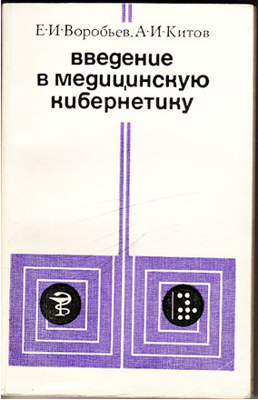
E.I. Vorobiev, A.I. Kitov "Introduction to Medical Cybernetics". Moscow. Publising house "Meditsina", 1977, 287 p.
The second monograph by A.I. Kitov on medical cybernetics, in which he summarized his experience in the implementation of medical computer systems in the organizations of the Ministry of Health of the USSR and, first of all, in medical institutions of his 3rd Main Directorate, responsible for public health and the organization of treatment for employees of the atomic Industry.
This book describes advanced foreign achievements in the field of medical informatics as well.
During twelve years A.I. Kitov was the official representative of the USSR in honorable organizations in the field of medical informatics at the UN and UNESCO - in the Technical Committee No. 4 of the International Federation for Information Processing (TC4 IFIP) and in the International Federation for Medical Informatics (MedINFO). A.Kitov also was among seven leaders of the International Association of Medical Informatics (officer of IMIA).

Slide 19
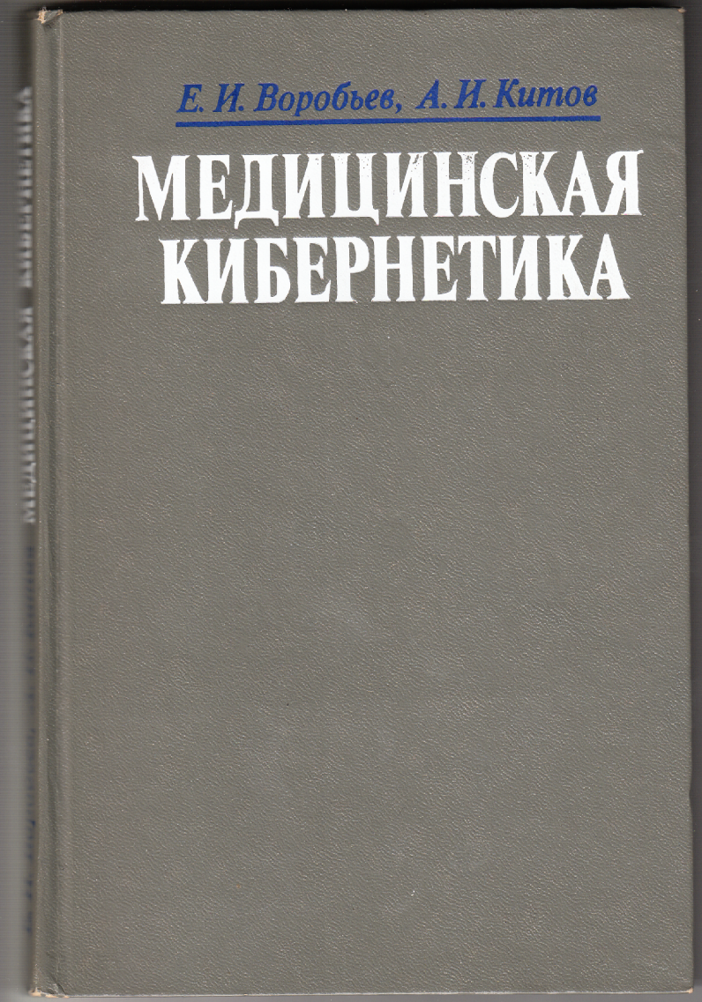
E.I. Vorobiev, A.I. Kitov "Medical cybernetics"
Moscow. Publishing house "Medicine", 1983
This third monograph of A.Kitov is devoted to the problems of medical cybernetics, sums up the "medical period" of his scientific activity.
It should be noted that under the leadership of A.I.Kitov, as the chief designer of the Automated Management System of the Ministry of Health, solutions for diagnostic information systems in the field of radiation and drug therapy were created, as well as information system "The Oncological Register".
In the USSR A.Kitov began research in the field of medical cybernetics practically from scratch and he managed to advance medical cybernetics of the country for several decades ahead. His scientific results in the field of medical informatics and computer systems in management are still relevant today.

Slide 20
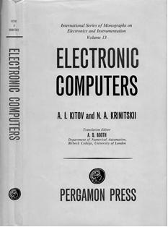
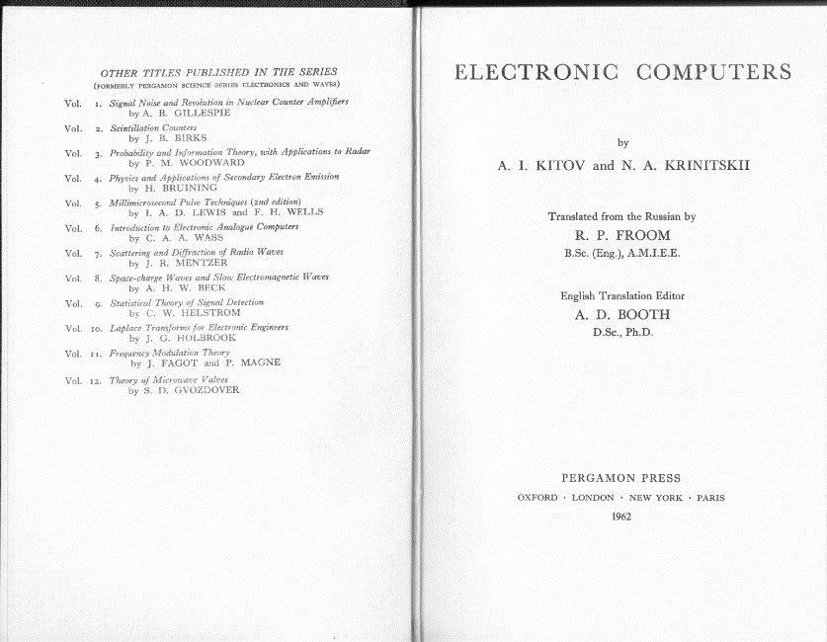
A.I. Kitov and N.A. Krinitskii “Electronic computers”
Oxford, London, New York, Paris.
Publishing house «Pergamon Press», 1962.
Famous international publishing house "Pergamon Press" (Oxford, London, New York, Paris) published the book "Electronic computers" of A.Kitov and N.Krinitsky (1958). The scientific editor of this English edition was the world-famous computer scientist professor A.D.Booth. The publication was carried out within the international series of monographs "International Series of Monographs on Electronics and Instrumentation".

Slide 21
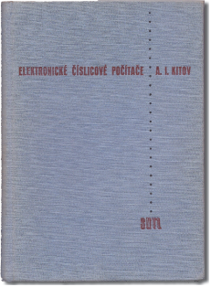
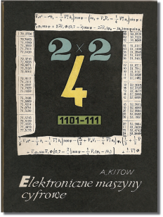
A.I.Kitov "Electronicke cislicove pocitace". Prague, 1960.
The publication in Czechoslovakia of the Kitov’s book “Electronic Digital Computers” (1956).
A.Kitow "Electroniczne maszyny cyfrove". Warsaw, 1959.
The publication in Poland of A.I. Kitov's book "Electronic digital Computers " (1956).

Slide 22

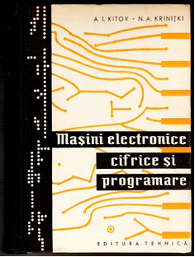
A.I. Kitov, N.A. Krinitki "Masini electronice cifrice si programare“. Romania, Bucharest, 1963
The publication in Romania of the textbook-encyclopedia of A.I. Kitov and N.A. Krinitsky "Electronic Digital Machines and Programming" (1961)
A.Kitow und N. Krinizki "Elektronische Digitalrechner und Programmierung“.
GDR, Leipzig, 1962
German edition of the textbook-encyclopedia by A.I. Kitov and N.A. Krinitsky "Electronic Digital Machines and Programming" (1959)

Slide 23

A. Kitow "Programmierung und Bearbeitung grosser Informationsmengen"
GDR, Leipzig, 1973
The German edition of A.I. Kitov's book "Programming information-logical problems" (1967).
This Kitov’s monograph describes the principles of solving with the help of computers a wide range of tasks such as material and technical supply, automated search for reference and patent information, update of bibliographies and many others, characterized by the need to process large amounts of data.
The monograph is devoted to a general description of scientific results obtained by the author in the field of the ALGEM algorithmic programming language that he created. The main purpose of ALGEM is to solve automatically economic problems.
Developed by A.I. Kitov "The theory of associative programming", contains a number of techniques and methods for the rapid search and processing of large arrays of economic data.

Slide 24
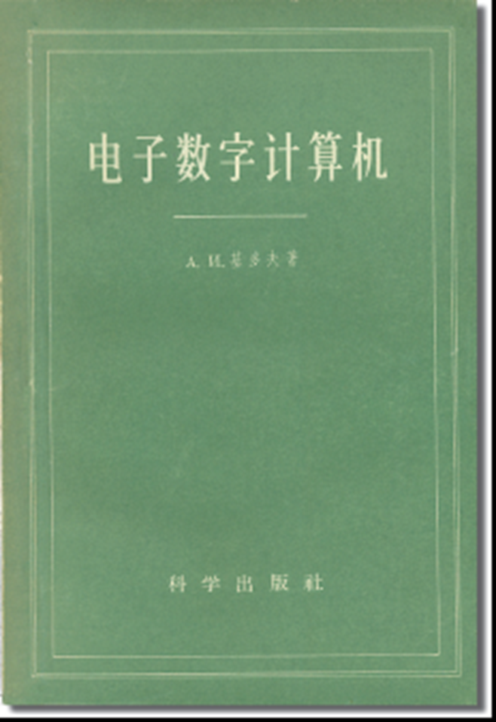
The publication in China of the A.I.Kitov's monograph "Electronic Digital Machines" (1956) Beijing, 1958.
In the 1950s because of the severance of China's relations with the United States and other Western countries, Chinese scientists were isolated. The first computer literature came to the People's Republic of China from the friendly Soviet Union. And these were two A.I. Kitov's monographs, which had a huge impact on the formation and development of Chinese computer engineering and programming.
The monograph "Electronic Digital Computers" (1956), was published in China in October 1958. In China, as in the USSR, this book by A.I. Kitov became the first book in the native language about computers, programming and their applications.
China's professor Zhang Wei recalls: "The translation of A.Kitov's book "Electronic Digital Computers" I and my wife began in 1957. We experienced tremendous difficulties, in particular, in the field of terminology and understanding of the principles of computer, because in China at that time there were no similar books and because in the USSR itself this book was the first". Translation of another book by A.I. Kitov - "Electronic computers" (co-authored with N.Krinitsky, Publishing House "Nauka" of the USSR Academy of Sciences, 1958) - was published in China in March 1961. At that time, the Chinese edition of two books by A.I. Kitov significantly exceeded the total circulation of all other computer books published in China. The reasons for the phenomenal success of these A.I. Kitov's books, according to Professor Zhang Wei and his colleagues, was that their content was extremely rich and informative for the first generations of Chinese computer specialists.

Slide 25
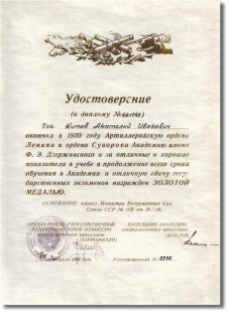
A certificate of Anatoly Kitov graduating from the Artillery Academy named after
F.E.Dzerzhinsky (now named after Peter the Great) with the Gold Medal.

Slide 26
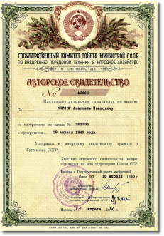
Author's certificate of A.I. Kitov with a priority from 10.04.1949 on his invention of "Jet cannon".
In the fall of 1948, A.I. Kitov became a fifth year student of the military academy. He already had serious achievements in scientific research. In particular, he participated in the project on the creation of S.P.Korolev's first Soviet missile "R-1".
By the fifth year of study in the military academy A.I.Kitov was already the author of three scientific articles on the missile theme and was near to completing of his invention of a new type of jet weapon - the "Jet Cannon". His invention along with the number of other promising military inventions were presented in the report to the head of the USSR I.V.Stalin.

Slide 27
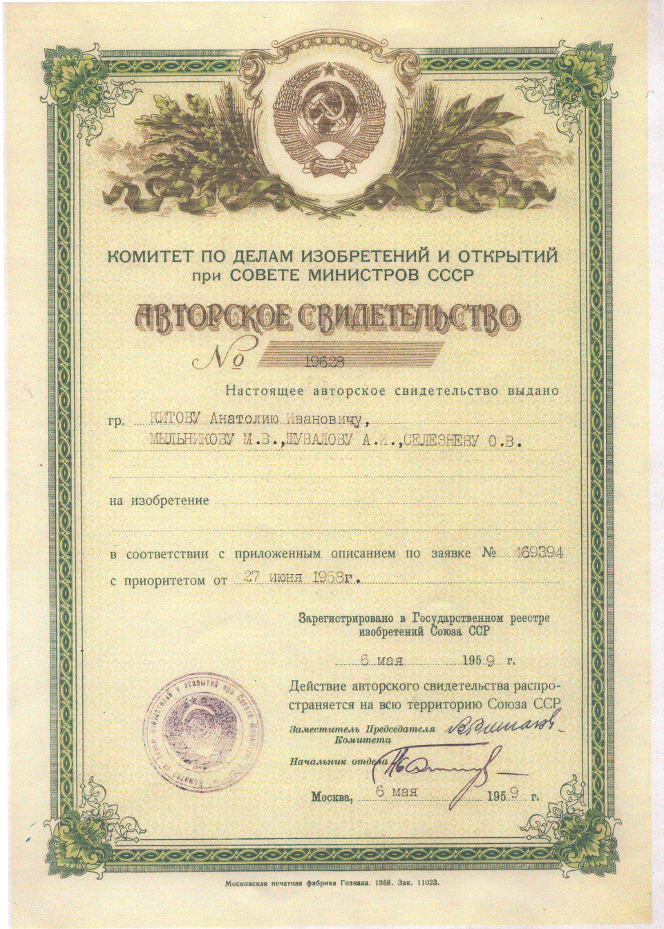
The principle of parallel processing of computer (machine) commands (instructions) by the Central processor is used by modern computers and is known as the principle of pipelining processing of computer instructions.
This method was used by A.I. Kitov in creating under his leadership computer "M-100" (one hundred thousand operations per second).
It made "M-100" the fastest in the world vacuum tube computer. Its record speed was also promoted by under Kitov scientific leadership's development of two-level RAM (cache memory and RAM) and a number of other innovations.
The A.I.Kitov's author's certificate with the priority of June 27, 1958 for the invention of the principle of parallel processing of machine instructions (The principle of parallel pipeline processing of the instructions of computer - principle of a macro-conveyor).

Slide 28

Yannick Harrel "La Cyber Strategie Russe" (Yannick Harrell "Russian cybernetic strategy")
Publisher "NUVIS" (Paris, France), 2015, 246 p.
The book of the well-known political scientist, expert of the European Union Y. Harrel is devoted to the history and the present of Russian information and communication technologies, computer networks and computer data processing systems.
The information in this book is retrospective and compares Soviet technologies with similar technologies developed in the US and in the Western Europe.
A significant place in the book is devoted to scientific projects of A.I.Kitov. The great importance of his scientific and practical activity for world and Russian informatics and cybernetics is underlined.
This book, Professor Yannick Harrel dedicated to the memory of "the outstanding scientist Anatoly Kitov".

Slide 29

Benjamin Peters «How not to network a Nation: the Uneasy History of the Soviet Internet».
Publishing house «The MIT Press» (Cambridge, Massachusetts & London, England), 2016, 298 p.
American professor of communication technology at the University of Tulsa Benjamin Peters in this book in detail and with great respect told about the work of two outstanding Soviet scientists Anatoly Kitov and Viktor Glushkov who were engaged in the creation of advanced information and communication technologies.
This book repeatedly emphasizes the fact that Soviet and American scientists almost simultaneously took many important steps in the field of creating and developing information and communication technologies.
At the same time, Soviet scientists often outstripped their American counterparts.
As an outstanding scientific result, Professor B. Peters highlights the fact that Anatoly Ivanovich Kitov was the first in the world who suggested to unite all the computers of the country (the USSR) into a single nationwide computer network - a prototype of the modern Internet.

Slide 30
Russian Plekhanov University of Economics
Educational and Scientific Center "Cybernetics"
Department of Informatics
The main scientific publications
of the head of the department of computer technology and programming of Russian Plekhanov University of Economics, Honored Worker of Science and Technology of the USSR, academician of the Russian Academy of Natural Sciences, doctor of Technical Sciences, professor
Anatoly Ivanovich Kitov
Key words: A.I.Kitov, pioneer of cybernetics, computers in economics, first internet project, military informatics, medical informatics, EGSVC, OGAS.
Compilers and editors:
Associate Professor Muzychkin Pavel Arsenovich
Associate Professor Kitov Vladimir Anatolievich
Senior Teacher Nedelkin Alexey Alexandrovich
2017

Slide 31
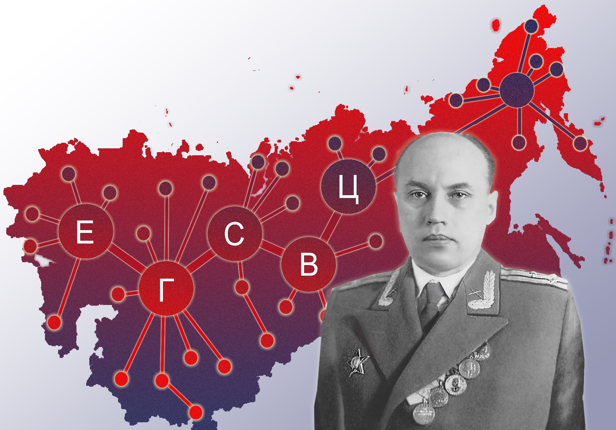
The Unified State Network of Computing Centers
Anatoly Ivanovich Kitov
Head of the department of computer technology and programming of Russian Plekhanov University of Economics, Honored Worker of Science and Technology of the USSR, academician of the Russian Academy of Natural Sciences, doctor of Technical Sciences, professor

